Slide 1
Star Wars Quiz Game!
By Nicolas Angel

Slide 2
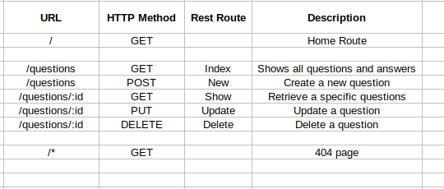
Route Table

Slide 3
The API
Star wars API: https://swapi.dev/

Slide 4
User
Id : string
Username: string
Password: string
Category
Id: string
Name: string
Quiz Result
Id: string
User id : string
Score: number
Question
Id: string
Question text: string
Correct answer: string
Incorrect answers:
-Answer 1
-Answer 2
-Answer 3

Slide 5
Star Wars Quiz App
Difficulty
Curious?
Log in?
Easy
Sign Up?
Med
Hard

Slide 6
Difficulty: Easy
User : nickangel
What is the name of the bounty hunter who captures Han Solo in The Empire Strikes Back?
Dengar
Bossk
IG-88
Boba Fett

Slide 7
User Profile
User : nickangel
Username: nickangel
Best Score:
Worst Score:
Highest Difficulty:
10/10
3/10
Hard

Slide 8
Curious?
User : nickangel
Brush up those skills and get back out there! You are the chosen one!
Movies
Star Ships
Planets
Characters
Vehicles
Species

